Slide 1
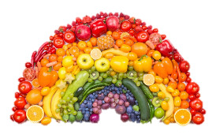

Nutrition Basics
Remember Energy Balance → eat enough to fuel your workouts daily.
Balance Carbohydrates (CHO), Protein & Fat
Nutrient | Function | Best Sources
CHO | Body & brain’s main source of energy | Whole wheat grains/pasta/rices, cereal, oatmeal, fruits, veggies, low-fat dairy.
Protein | Makes up muscles, tissue, hormones, enzymes, and more! | Low-fat dairy, lean meats (chicken/turkey/pork/beef), fish, shrimp, tofu, soy-based proteins, beans, eggs, nuts.
Fat | Long-term energy source, cushions organs, helps absorb vitamins, anti-inflammatory | Olive/canola/vegetable oil, nuts, seeds, olives, avocadoes, fish, seafood
Focus on eating the rainbow: the more color, the better
Eat every 3-4 hours…do not skip meals!
Build a Balanced Plate at Each Meal
Lighter Training/Days Off
Heavy Training/Game Day
25% Healthy Carbs
Water
50% Healthy Carbs
Water
50% Veggies
25% Lean Protein
25% Veggies
25% Lean Protein

Slide 2
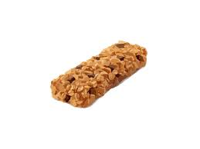


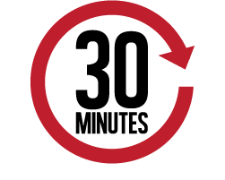




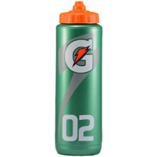

Fueling Before, During, and After Exercise
Pre-fuel and In-Game Fuel: Eat a carbohydrate snack about 30-60 minutes before the game & then every 45-60 minutes during play to keep your energy levels up. Pre-fuel snack should be rich in simple carbohydrates for immediate energy and low in fiber and fat to prevent upset stomach.
  Applesauce, fresh or dried fruit, cereal, granola bar, Gatorade, gummies or gels..
Refuel: Eat a snack within 30 minutes after your game that has a combination of protein and carbohydrates to replace the energy stores & to repair of damaged muscle tissue
  Muscle Milk, Muscle Milk Bars, Chocolate Milk, Greek Yogurt, Trail Mix.
HYDRATION
Even a small amount of dehydration negatively impacts performance:
  Decreases speed & power (slower)
  Impairs cognitive function (unable to focus)
  Burns more carbs for fuel (fatigue sooner)
Carry a water bottle with you at all times!
Choose Gatorade for hydration to replace electrolytes when your training lasts longer than 60 minutes.
After a practice, lift, or game you should rehydrate with 16-24oz fluid for every pound of body weight lost.

